Slide 1

ACCESSIBLE CARE TO EVERYONE
“HEALTH TECH HORIZONS”
“Digital Health Revolution: Bridging Gaps and Fostering Well-being Through Innovative Technologies.“

Slide 2

“HEALTH TECH HORIZONS”
TEAM
01. ROSHNI VS GOWDA 2023CI0041
02. VIKRAM A 2023CI0035
03. SOUPARNIKA R 2023CI0028
04. SAMEEKSHA M URS 2023CI0100
05. YAJNITH K 2023CI0034

Slide 3
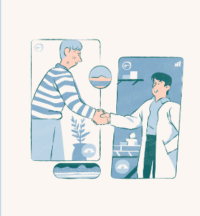
PROBLEM STATEMENT
Propose inventive tech interventions for promoting good health and well-being, emphasizing preventive healthcare, mental health support, and equitable access to medical resources.
SOLUTION DESCRIPTION
Our solution combines AI-driven preventive healthcare apps and wearables, teletherapy platforms, and blockchain-enabled telemedicine for global health. It ensures personalized preventive care, mental health support, and universal access to medical resources, fostering a proactive and inclusive healthcare future.

Slide 4
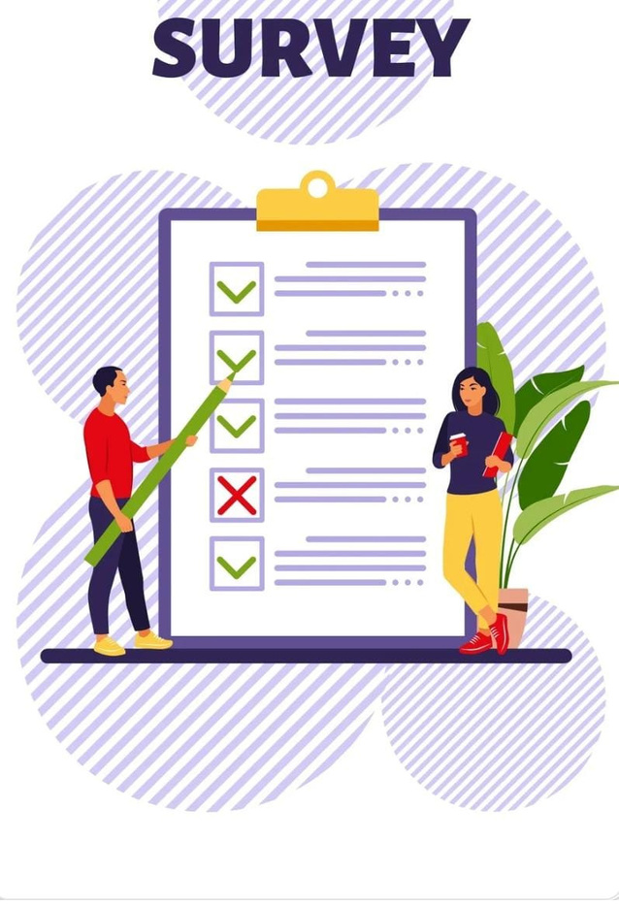
“WELLNESS WISDOM WEIGN-IN“

Slide 5
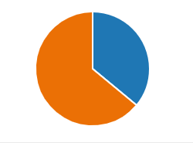
“HEALTH TECH HORIZON“
1.DO YOU STAY IN RURAL AREA OR URBAN AREA?
RURAL AREA 72
URBAN AREA 128

Slide 6
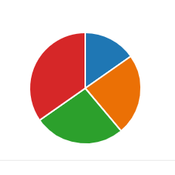
RURAL AREA
2. HOW EASILY CAN YOU ACCESS ESSENTIAL MEDICATIONS IN YOUR PLACE?
EASILY AVAILABLE 11
NEUTRAL 17
SOMEWHAT DIFFICULTY 19
VERY DIFFICULT 25

Slide 7
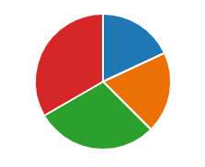
3. DO YOU FEEL WELL-INFORMED ABOUT THE PROPER USAGE AND DOSAGE OF THE MEDICATION YOU TAKE?
WELL INFORMED 13
NEUTRAL 14
SOMEWHAT INFORMED 21
VERY UNINFORMED 24

Slide 8
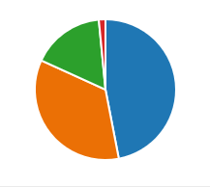
4. DO YOU RELY ON HOME REMEDIES OR ALTERNATIVE MEDICINE DUE TO LIMITED ACCESS TO PHARMACEUTICALS IN YOUR RURAL SETTING?
YES, FREQUENTLY 31
OCCASIONALLY 23
RARELY 11
NEVER 01

Slide 9
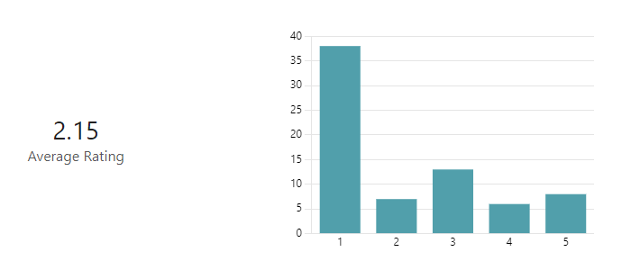
5. ARE THERE TRANSPORTATION CHALLENGES THAT AFFECT YOUR ABILITY TO OBTAIN MEDICATIONS IN YOUR RURAL AREA?

Slide 10
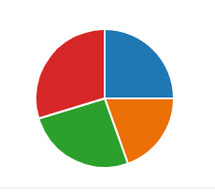
URBAN AREA
6. ARE THERE RELIABLE DELIVERY SERVICES OR ONLINE PLATFORMS THAT YOU USE FOR MEDICATION PURCHASES IN YOUR URBAN SETTING?
YES, REGULARLY 32
YES, OCCASIONALLY 25
NO, PREFER IN-PERSON 33
PURCHASES
NO, NOT AWARE OF SUCH 38
SERVICES

Slide 11
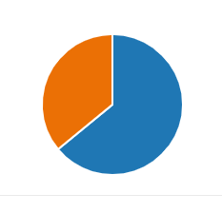
7. DO YOU OFTEN VISIT MULTIPLE PHARMACIES TO FIND THE MEDICATIONS YOU NEED, OR DO YOU TYPICALLY FIND EVERYTHING IN ONE LOCATION?
MULTIPLE PHARMACIES 82
EVERYTHING IN ONE 46

Slide 12
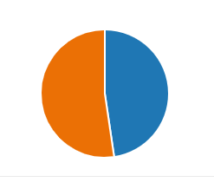
8. DO YOU CURRENTLY USE ANY WEARABLE HEALTH DEVICES, SUCH AS FITNESS TRACKERS OR SMARTWATCHES?
YES 61
NO 67

Slide 13
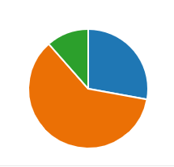
9. HOW OFTEN DO YOU RELY ON DATA FROM WEARABLE HEALTH DEVICES TO MONITOR YOUR PHYSICAL ACTIVITY AND HEALTH?
REGULARLY 17
OCCASIONALLY 37
NEVER 07

Slide 14
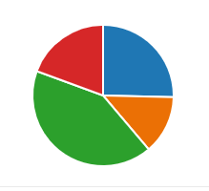
10. WHAT FACTORS CONTRIBUTE TO YOUR DECISION NOT TO USE WEARABLE HEALTH DEVICES?
COST 17
LACK OF PERCEIVED 09
BENEFITS
PREFER TRADITIONAL 28
BENEFITS
OTHER 13

Slide 15
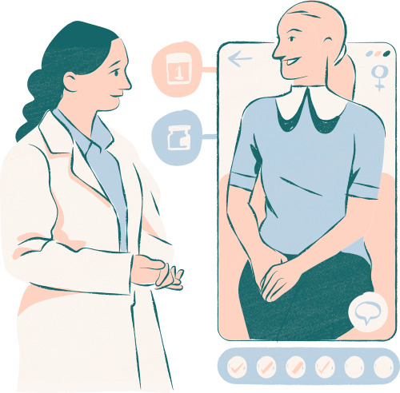
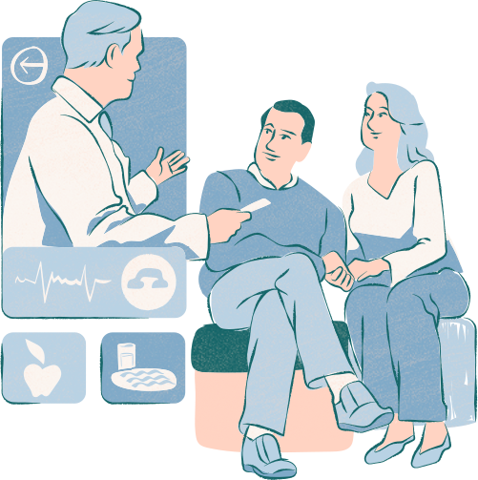

Slide 16
Thank you very much!

